Slide 1
A Flowering of Faith:
Christianity and Buddhism
400 B.C.E.-300 C.E.

Slide 2
The Background to Christianity
Greco-Roman:
Roman religion, like Roman culture itself, was a blend of native and borrowed traditions. The Romans welcomed the gods of non-Roman people, and embraced the Greek gods. The tolerance for non-Roman cults contributed to the lack of religious uniformity, as well as to wide spread speculation concerning the possibility of life after death.
Along with hosting a variety of religious beliefs, Rome also practiced a number of quasi-religious Hellenistic philosophies, of which Stoicism and Neoplatonism. Stoicisms ethical view of life and its emphasis on equality among human beings offered an idealized alternative to a social order marked by wide gaps between rich and poor.
Neoplatonism took as its inspiration some of the principal ideas in the writings of Plato, and anticipated a mystical union between the individual soul and “the One” or Ultimate Being. Neoplatonism’s view of the soul as eternal and divine, and its perception of the universe as layered in ascending degrees of perfection, would have a shaping influence on early Christian thought.
By the second century, Rome enjoyed an imperial cult that honored the living emperor as semi divine and deified him after his death.

Slide 3
Near Eastern Background:
In Greece, Egypt and throughout Southwest Asia, there has long flourished numerous religious cults whose appeal was less intellectual than that of Neoplatonism and more personal than that of the Greco-Roman religious philosophies.
The promise of personal immortality was the central feature of the “mystery cults,” so called because their initiation rituals were secret. The cults of Isis in Egypt, Dionysus in Greece, and Mithra in Persia, had a heritage dating back to Neolithic times.
Ancient agricultural societies celebrated seasonal change be means of symbolic performances of the birth, death, and rebirth of the gods and goddesses associated with the regeneration of crops, and the mystery cults perpetuated these practices. The initiates participated in symbolic acts of spiritual death and rebirth, including ritual baptism and a communal meal, at which they might consume the flesh or the blood of the deity. Sound familiar?
Although the mystery cults often involved costly and demanding rituals, they were successful in attracting devotees. The Romans readily accommodated the exotic gods and goddesses of these cults as long as their worship did not challenge the authority of the Roman imperial cult or threaten the security of the Roman state.

Slide 4
Jewish Background:
Judaism, the oldest living religion in the Western world, differed from the other religions and religious cults of this period in its strongly ethical bias, its commitment to monotheism, and its exclusivity, that is, its emphasis on a special relationship between God and the Jews themselves.
Following the 60 years of exile known as the Babylonian Captivity, the Hebrews returned to Jerusalem, re-built the Temple of Solomon, and renewed their faith in the Torah. Under the influence of the teacher Ezra, the books of the Bible became even more central in shaping the Hebrew identity. With the eastward expansion of Alexander the Great, the Jews were “Hellenized,” and by the second century B.C.E. a Greek translation of Hebrew scriptures appeared.
The homeland of the Jews became the Roman province of Judea in 63 B.C.E., when the Roman general Pompey captured Jerusalem. Judaism, a monotheistic faith, refused to worship Rome’s rulers or Rome’s gods, and this culminated in Rome’s assault on the city, and the destruction of the second temple in 70 C.E. Not until 1948, when the independent state of Israel came into being did Judaism have a primary location in the world.
Early Judaism’s biblical interpretation was informed by two groups. The Sadducees, a learned sect of Jewish aristocrats envisioned the Messiah as a historical leader who would consolidate Jewish ideals and lead the Jews to political freedom. Defending a literal interpretation of the Torah, they denied the soul survived the death of the body. The Pharisees, the more influential group of Jewish teachers and the principal interpreters of Hebrew law, believed in the advent of a messianic redeemer who, like a shepherd looking after his flock, would lead the righteous to salvation. In their view, the human soul was imperishable and the wicked would suffer eternal punishment.

Slide 5
The Life of Jesus:
In some of the oldest extant fragments of the Hebrew Bible, The Dead Sea Scrolls, it was forecasted that an apocalyptic age marked by the coming of a Teacher of Righteousness. That leader proved to be a poor, young Jewish rabbi from the city of Nazareth named Jesus.
His name is not mentioned in the non-Christian literature until almost the end of the first century C.E. The Christian writing that describe his life and teachings, known as the Gospels, date from at least 40 years after his death. Nevertheless, the Gospels constitute a body of revelations, beginning with the miraculous birth of Jesus and his baptism by the preacher John at the Jordan River in Galilee. Written in Greek and Aramaic, the Gospels describe the life of a charismatic teacher, healer, and reformer, who proclaimed his mission to “complete” Hebrew law, and fulfill the lessons of the prophets.
While Roman authorities viewed his presence in Jerusalem as subversive, the Pharisees and Sadducees accused him of violating Jewish law and contradicting Scripture. Many questioned his legitimacy as the Biblical Messiah. Finally, the Romans condemned him as a threat to imperial stability, and the Roman governor Pontius Pilate ordered Jesus put to death by crucifixion, a punishment normally dispensed to thieves and traitors.
All four of the Gospels report that Jesus rose from the dead on the third day after his death, and that he appeared to his disciples before ascending to heaven, and this act called the resurrection became fundamental to Christianity. In the earliest representations of Jesus, however, it is not his death on the cross, nor his reported resurrection, but his role as redeemer and protector-as Good Shepard- that is immortalized.

Slide 6
Iconography of the Youth of Christ in the Life of Jesus
The Annunciation: The archangel Gabriel announces to the Virgin Mary that God has chosen her to bear his son.
The Visitation: The pregnant Mary visits her cousin, Elizabeth, who is pregnant with the future John the Baptist.
The Nativity: Jesus is born to Mary in Bethlehem.
The Annunciation of the Shepherds: An angel announces the birth of Jesus to humble shepherds.
The Adoration of the Magi: Three wise men from the East follow a star to Bethlehem where they present the Christ child with precious gifts.
The Presentation in the Temple: Mary and Joseph present Jesus to the high priest at the Temple at Jerusalem.
The Massacre of the Innocents and the Flight to Egypt: King Herod murders all the newborn of Bethlehem, and the Holy Family flee to Egypt.
The Baptism: John the Baptist, a preacher in the wilderness of Judea, baptizes Jesus in the Jordyn River.
The Temptation: Jesus fasts for forty days and nights in the wilderness, he rejects the worldly wealth offered to him by the devil.
The Calling of the Apostles: Near the Sea of Galilee, Jesus calls the brothers Simon and Peter into his service.
The Raising of Lazarus: Jesus restores life to Lazarus, the brother of Mary and Martha.
The Transfiguration: On Mount Tabor, among his disciples, the radiantly transfigured Jesus is hailed by God as his beloved Son.

Slide 7
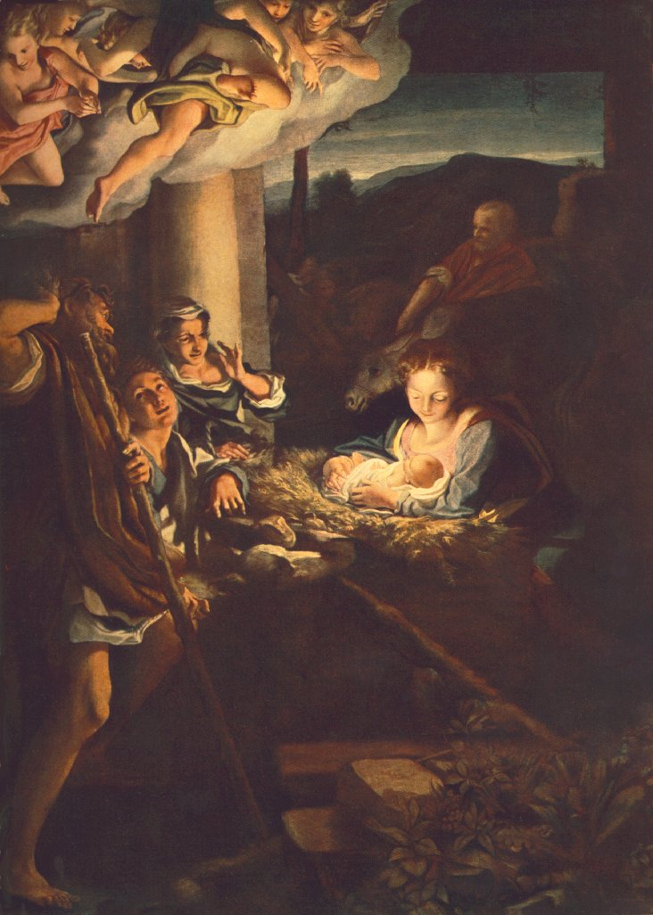
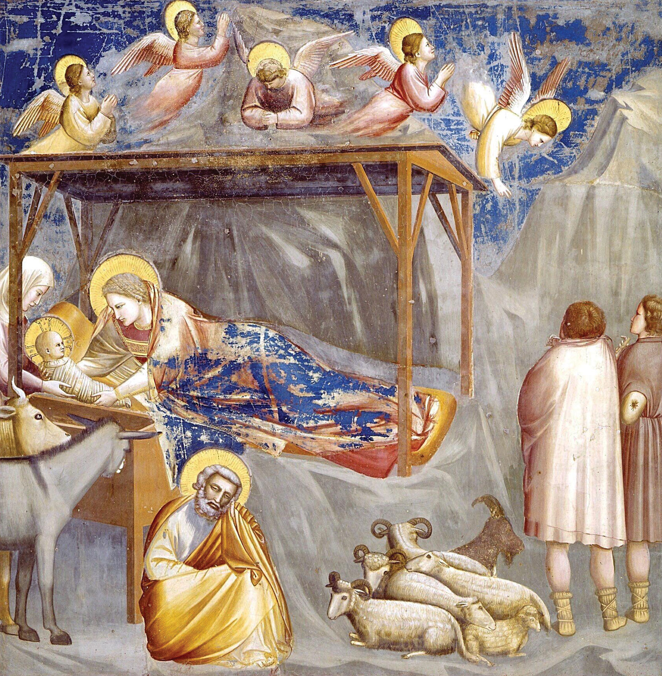
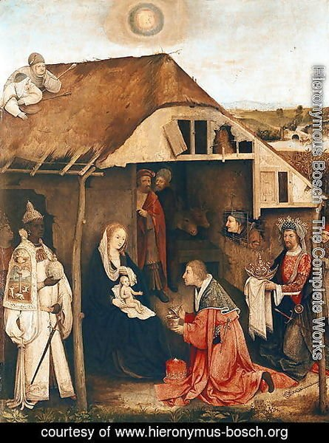
Antonio Correggio, 1522
Giotto di Bondone, 1305
Hieronymus Bosch, 1508

Slide 8
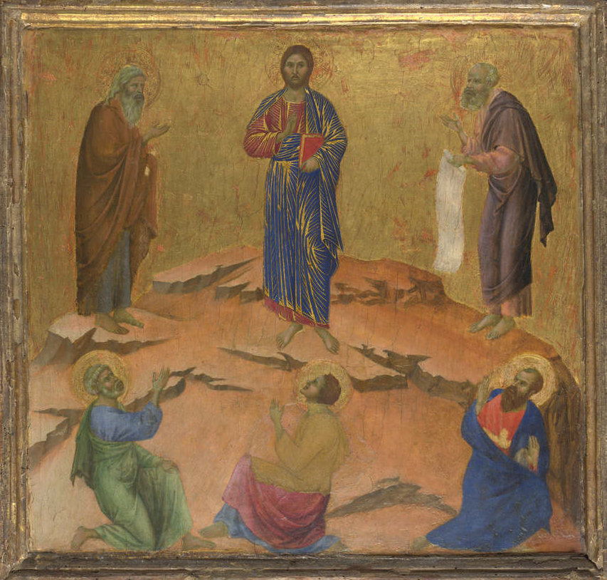
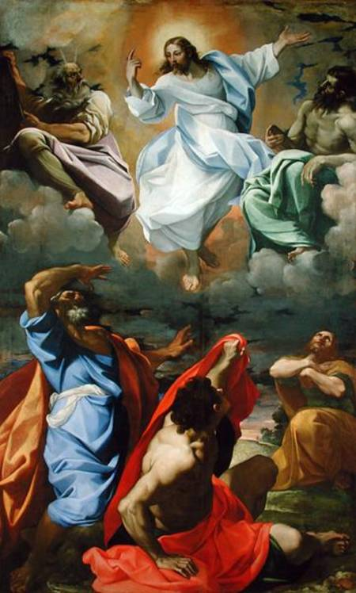
Duccio di Buoninsegna, 1311
Ludovica Carracci, 1595

Slide 9
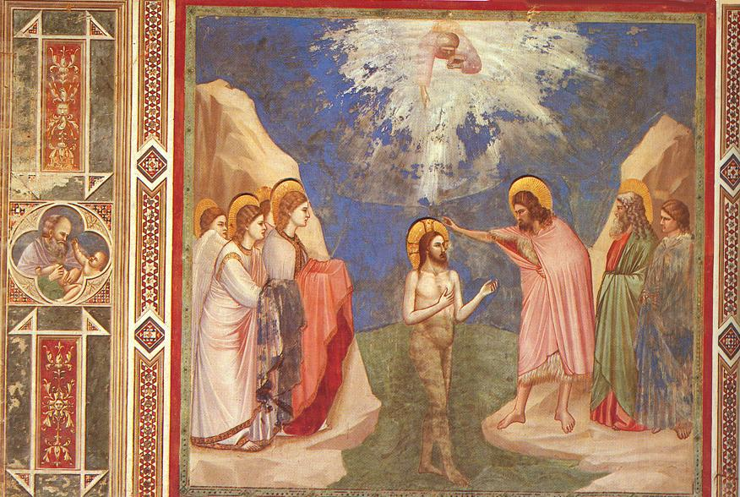
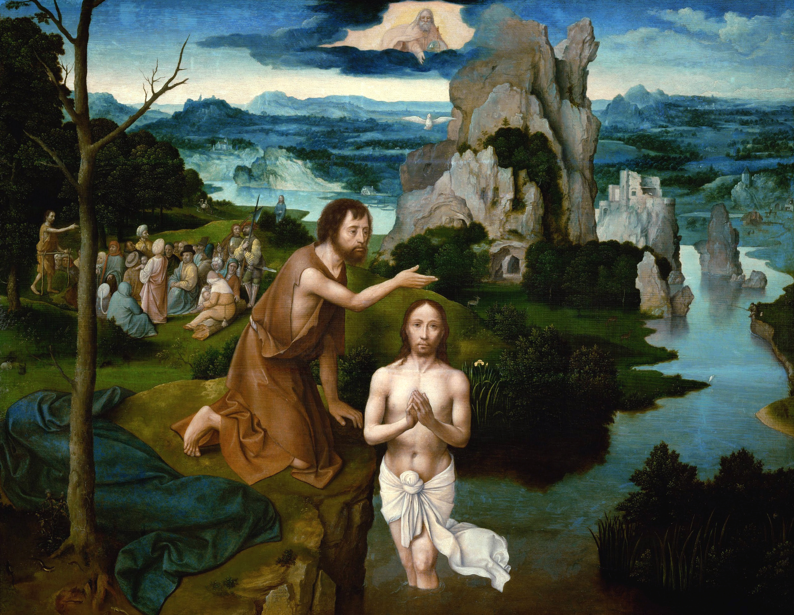
Giotto di Bondone, 1305
Joachim Patinir, 1515

Slide 10
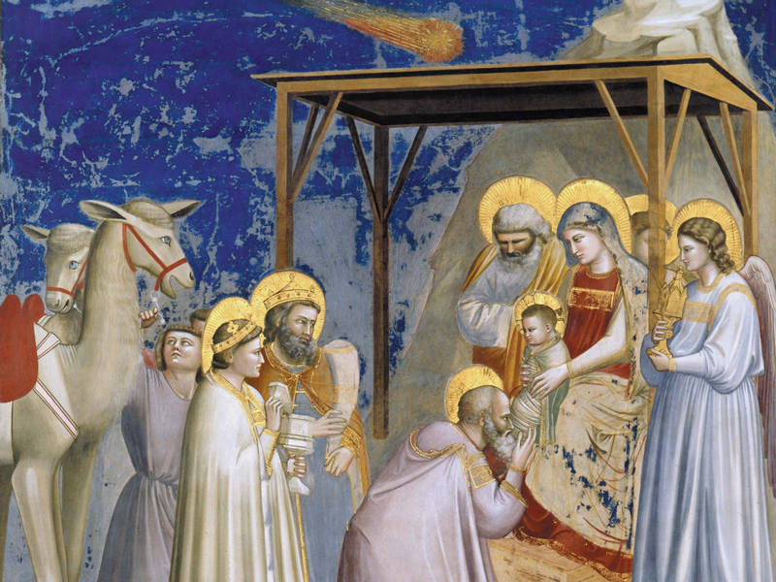
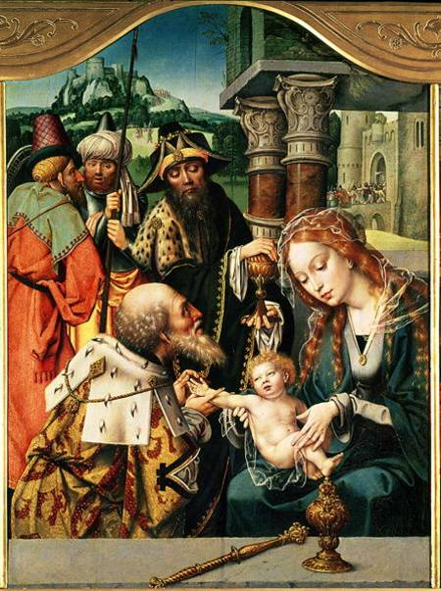
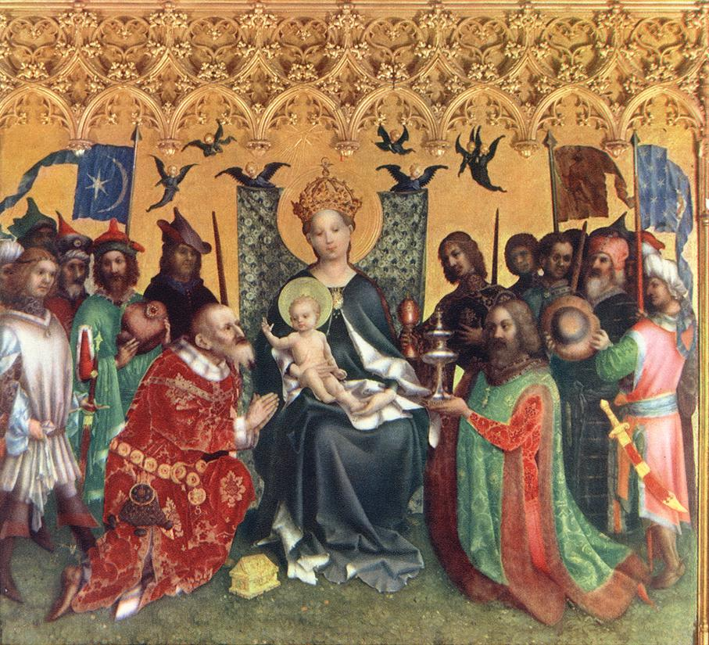
Giotto, 1305
Jan Gossaert, 1518
Stefan Lochner, 1440

Slide 11
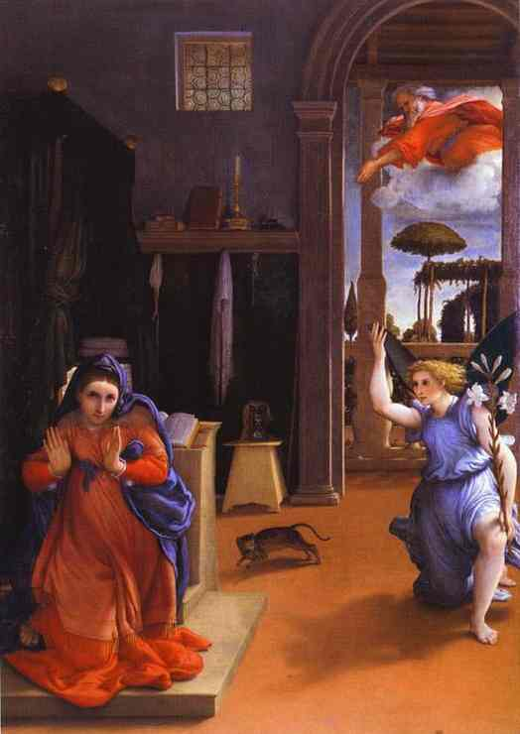
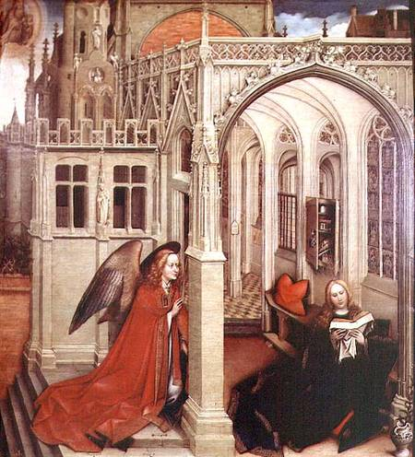
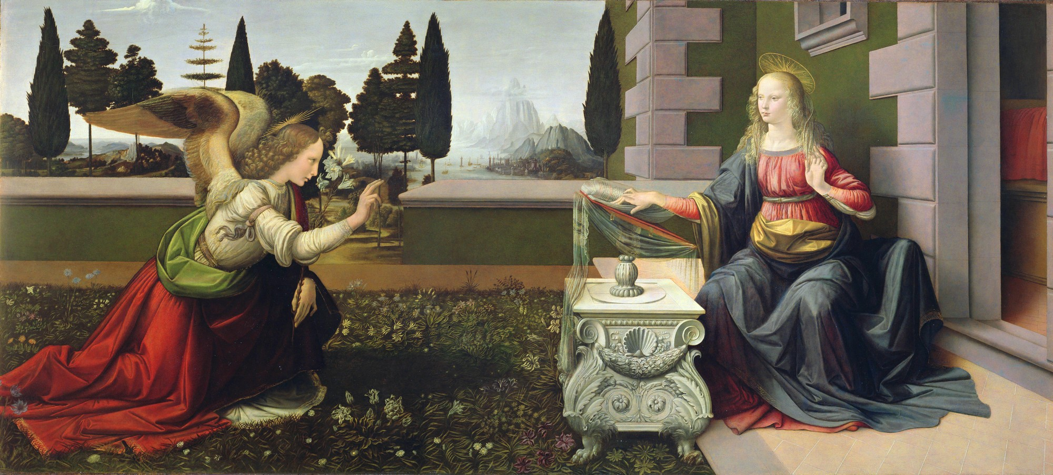
Lorenzo Lotto, 1534
Robert Campin, 1430
Leonardo da Vinci, 1475

Slide 12
Iconography of the Passion of the Christ in the Life of Jesus
The Entry into Jerusalem: Jesus, riding on a donkey, enters Jerusalem amidst his disciples and receptive crowds.
The Last Supper: At Passover, Jesus reveals to his disciples his impending death and instructs them to consume the bread and wine.
The Agony in the Garden: In the Garden of Gethsemane on the Mount of Olives, while the disciples Peter, James, and John sleep, Jesus reconciles his soul to death.
The Betrayal: Judas, who has been bribed to point Jesus out to his enemies, identifies him by kissing him as he leaves the garden.
Jesus before Pilate: Jesus comes before the Roman governor of Judea and is charged with treason; when the crowd demands that Jesus be put to death, Pilate washes his hands to signify his innocence of the deed.
The Flagellation: Jesus is terrorized by his captors, the Roman soldiers.
The Mocking of Jesus: Pilate’s soldiers dress Jesus in royal robes and put a crown of thorns on his head.
The Road to Calvary: Jesus carries the Cross to Golgotha where he is executed atop of the cross, raised to stand upright.
The Crucifixion: Jesus is crucified between two thieves.
The Descent from the Cross and the Lamentation: Grief-stricken followers remove the body of Jesus from the cross and mourn over it.
The Entombment: Mary and the followers of Jesus place his body in a nearby tomb.
The Resurrection: Three days after his death, Jesus rises from the tomb.

Slide 13
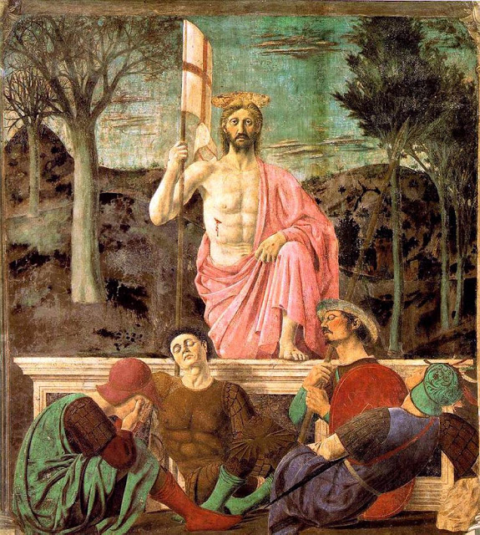
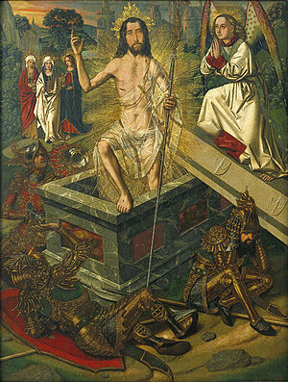
Pierro della Francesca, 1463
Bartolome Bermejo, 1480

Slide 14
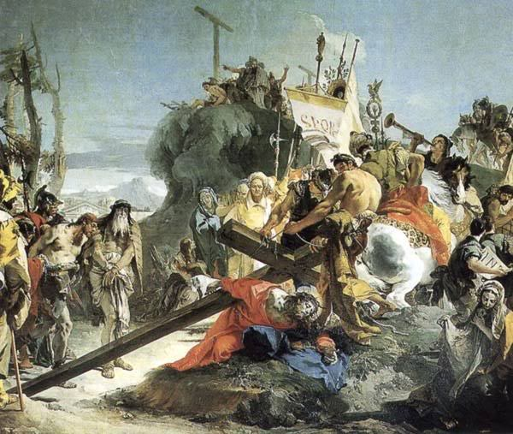
Giambattista Tiepolo, 1740

Slide 15
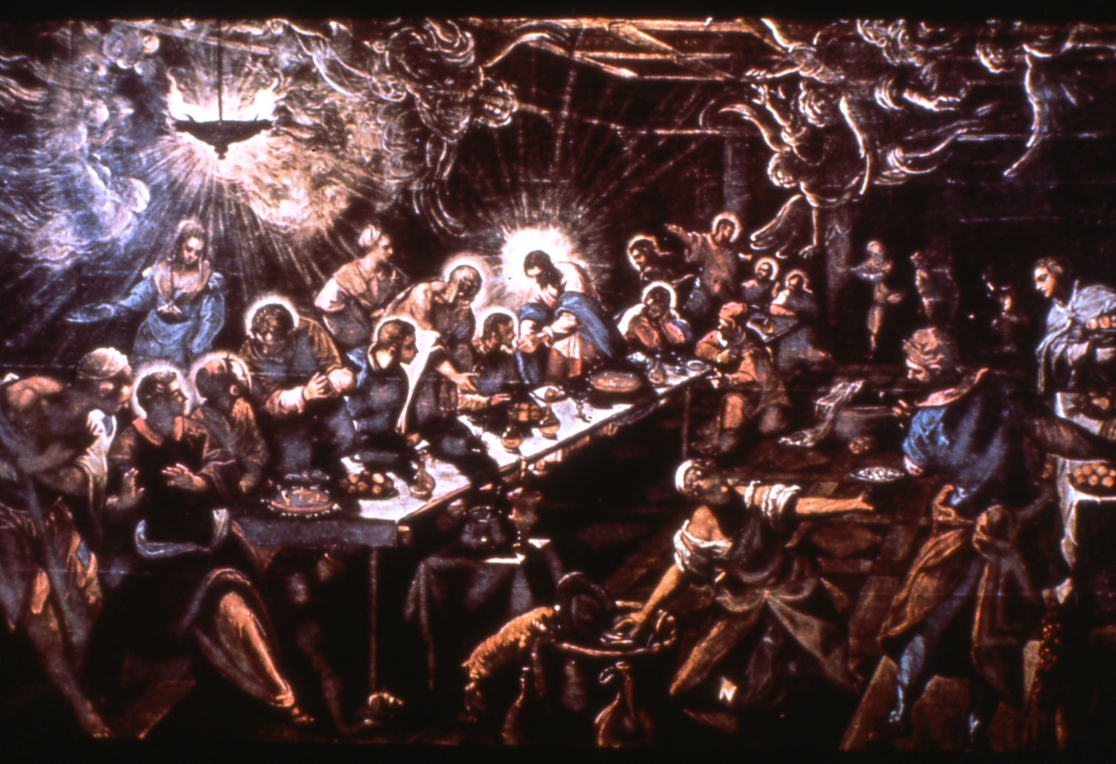
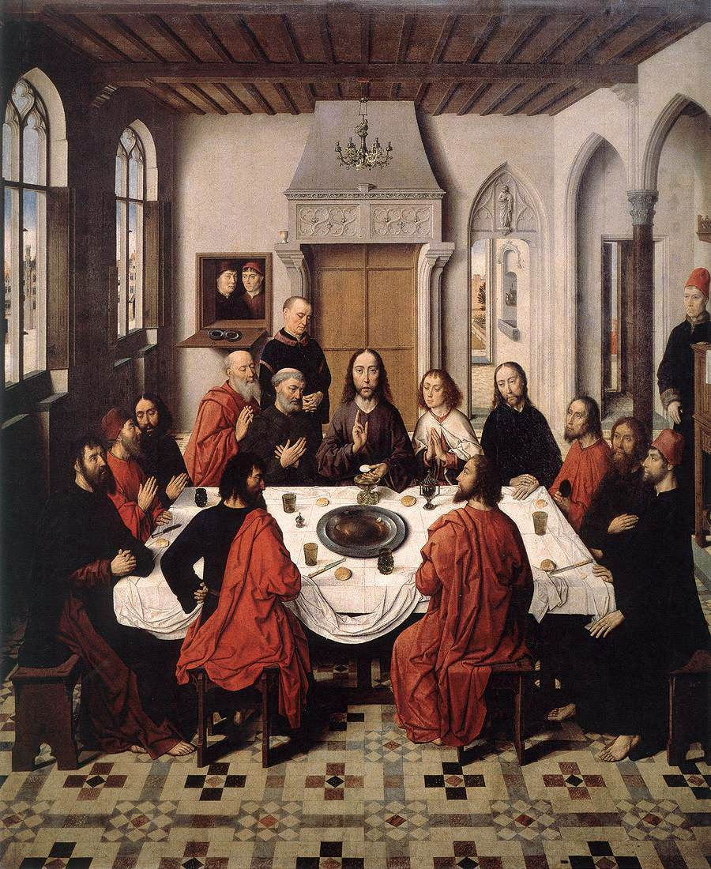
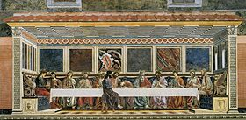
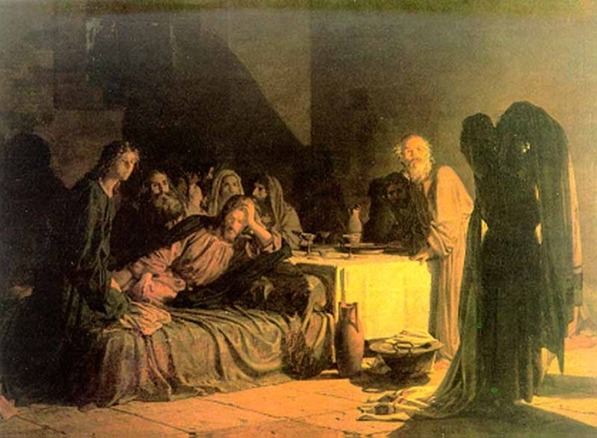
Jacopo Robusti Tintoretto, 1594
Dieric Bouts, 1468
Andrea del Castagno, 1447
Nikolai Ghe, 1863

Slide 16
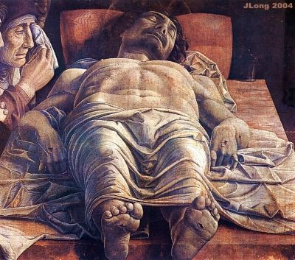
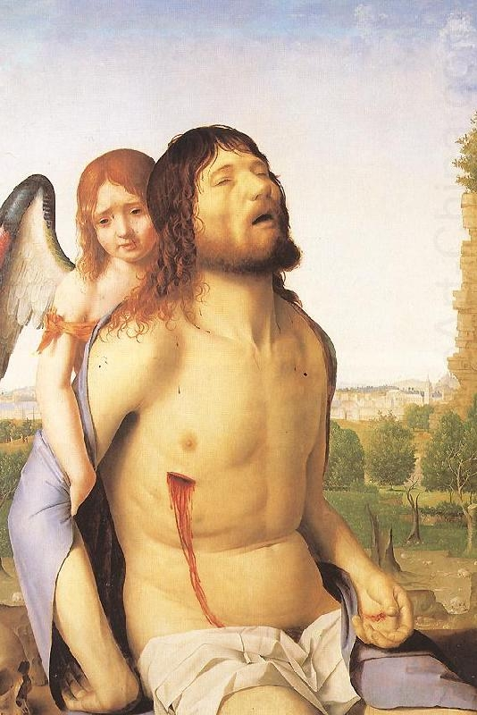
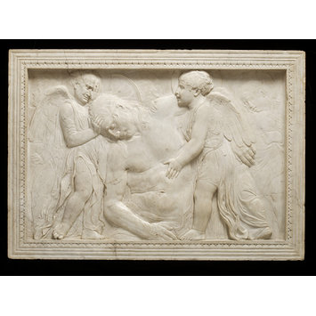
Andrea Mantegna, 1497
Left:
Donatello, 1435
Antonello da Messina, 1475

Slide 17
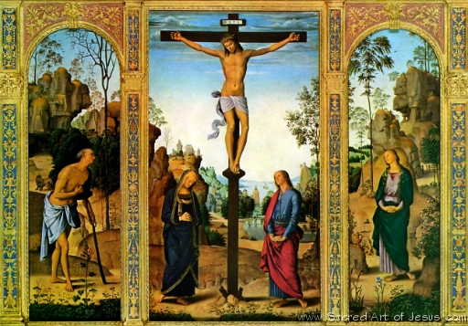
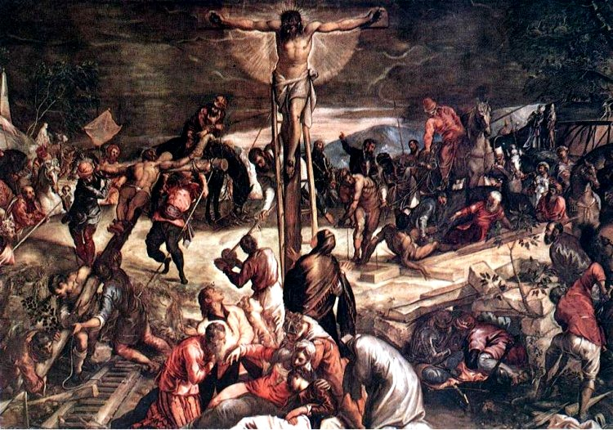
Pietro Perugino, 1493
Jacopo Robusti Tintoretto, 1565

Slide 18
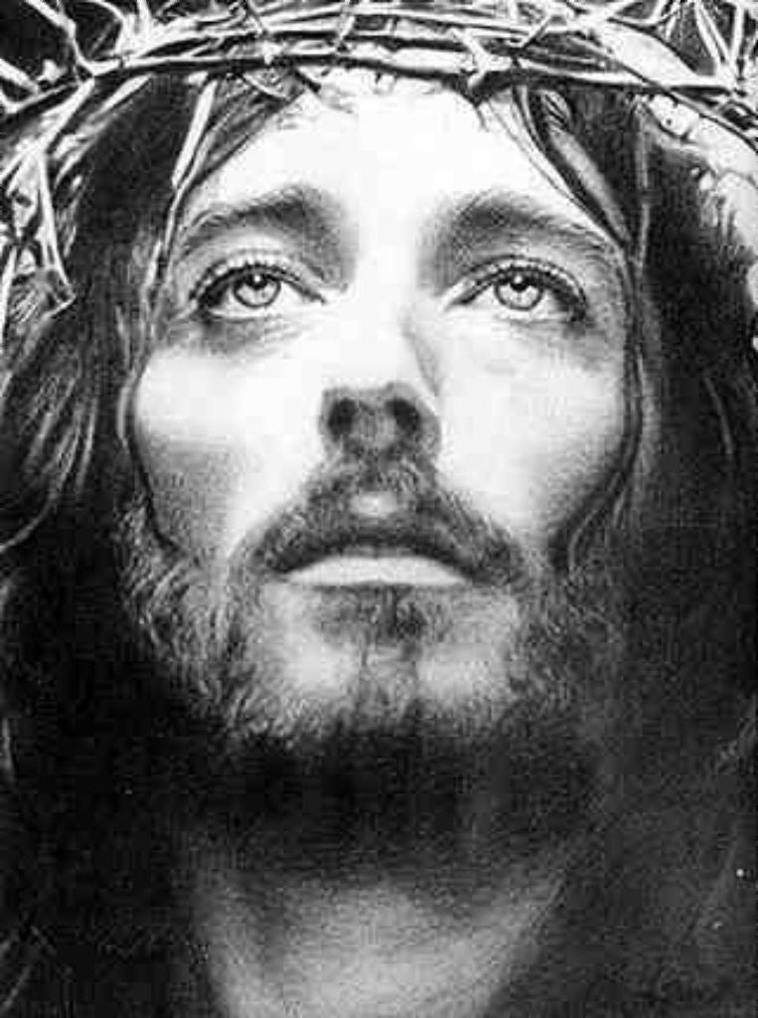
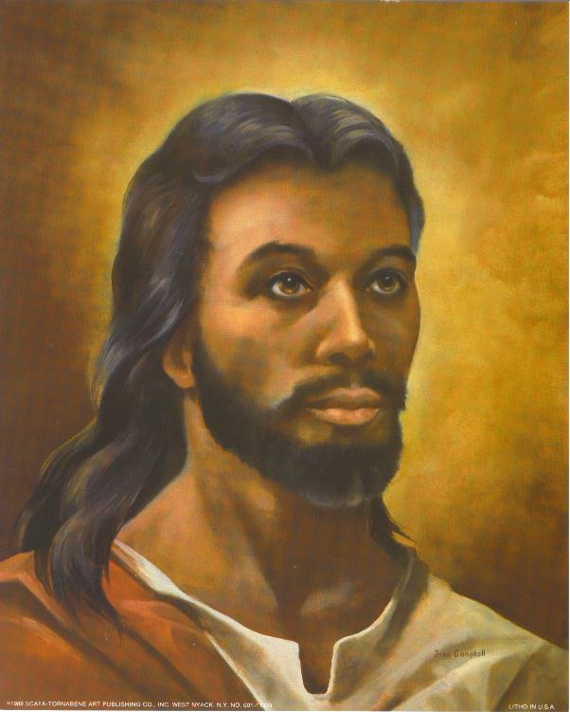
The Message of Jesus:
While the message of Jesus embraced the ethical monotheism of traditional Judaism, it gave new emphasis to the virtues of pacifism and compassion. It warned of the perils of wealth and the temptations of the secular world.
Jesus urged the renunciation of material possessions, not only as a measure of freedom from temporal enslavement, but as preparation for eternal life and ultimate reward in “the kingdom of heaven.”
Such teachings represented a new direction in the ancient thought, for, with few exceptions, such as the Stoics and Neo-Platonists, Classical culture was fundamentally materialistic.
Criticizing the Judaism of his time, with its emphasis on strict observance of ritual, Jesus stressed the importance of faith and compassion that lay at the heart of the Hebrew covenant: love of god and love of one’s neighbor. He embraced the spirit rather than the letter of the Hebrew law, picturing its omnipotent god as stern, but also loving, merciful, and forgiving.

Slide 19
The Teachings of Paul
Through the efforts of the best known of the apostles, Paul, the message of Jesus gained widespread appeal. A Hellenized Jew from Tarsus in Asia Minor, Paul had been schooled in both Greek and Hebrew. Following a mystical experience in which Jesus is said to have revealed himself to Paul, he became a passionate convert to the teachings of the preacher from Nazareth.
Paul in generally believed to have written ten to fourteen of the twenty-seven books of the Christian Scriptures, called by the Christians the “New Testament,” to distinguish it from the Hebrew Bible, which they referred to as the “Old Testament.”
Paul’s most important contributions lie in his having universalized the systematically explained Jesus’ message. While Jesus preached only to the Jews. Paul spread his teachings to the gentile communities of Greece, Asia Minor, and Rome, thus earning the title, “Apostle to the Gentiles.”
Paul stressed the following principals of Christianity. First, the words of Jesus were stressed to all peoples. Second, he described Jesus as a living sacrifice who died for the sins of humankind, and, specifically, for the sin that had entered the world through Adam’s defiance of God in the Garden of Eden. Third, the death of Jesus was an act of atonement that “acquitted” humankind of Original Sin. Fourth, Jesus’ resurrection confirmed the promise of eternal salvation, and fifth, by having faith in Jesus, the faithful would be rewarded with everlasting life.
So important was Pauls’ contribution to the foundations of the new faith that he has been called “the co-founder of Christianity.”

Slide 20
The Spread of Christianity
A variety of factors contributed to the slow but growing receptivity to Christianity within the Roman Empire. Amid widespread oppression and grinding poverty, Christianity promised redemption from sins, personal immortality, and a life to come from which material adversities were absent.
The message of Jesus was easy to understand, free of the cumbersome regulations of Judaism and the costly rituals of the mystery cults, and, in contrast to Mithraism, it was accessible to all- male and female, rich and poor, free and enslaved. The most unique feature of the new faith was its historical credibility, that is, the fact that Jesus, had actually lived among Judea’s men and women, and had practiced the morality he preached.
Nevertheless, the outset of the new religion failed to win official approval from the Roman Empire, because the new Christians refused to worship the emperor as divine, and refused to serve in the Roman army. During the first century, Christian converts were simply expelled from the city of Rome, but by the third century, the Christians who refused to make sacrifices to the Roman gods or state suffered horrific forms of persecution: they were burned, tortured, beheaded, or thrown to wild beasts in public amphitheaters.
Not until 313 C.E., when the emperor Constantine issued the Edict of Milan, did the public persecution of Christians come to an end. The Edict not only liberated Christians from political and physical oppression, but encouraged the development of Christianity as a legitimate faith.
Constantine came to the decision to legalize the religion after an apparent visit from God requiring him to act accordingly. This is most likely a rouse to insinuate that his position as emperor was “divinely appointed,” and he would retain power.

Slide 21
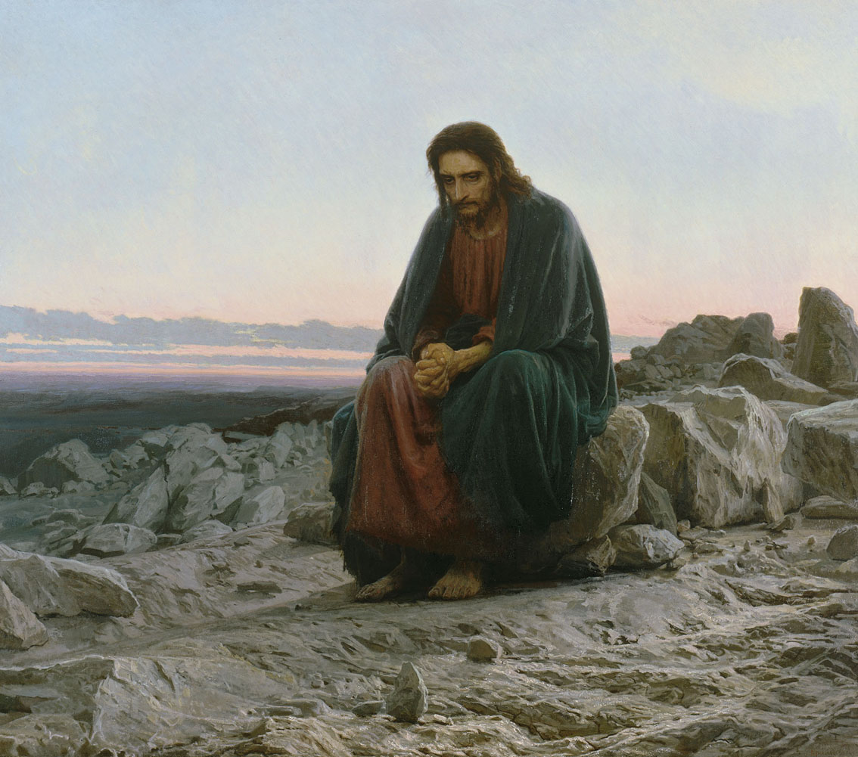
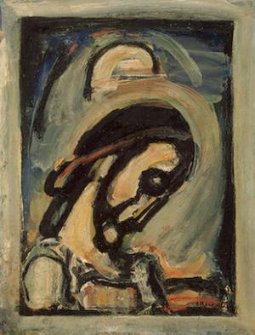
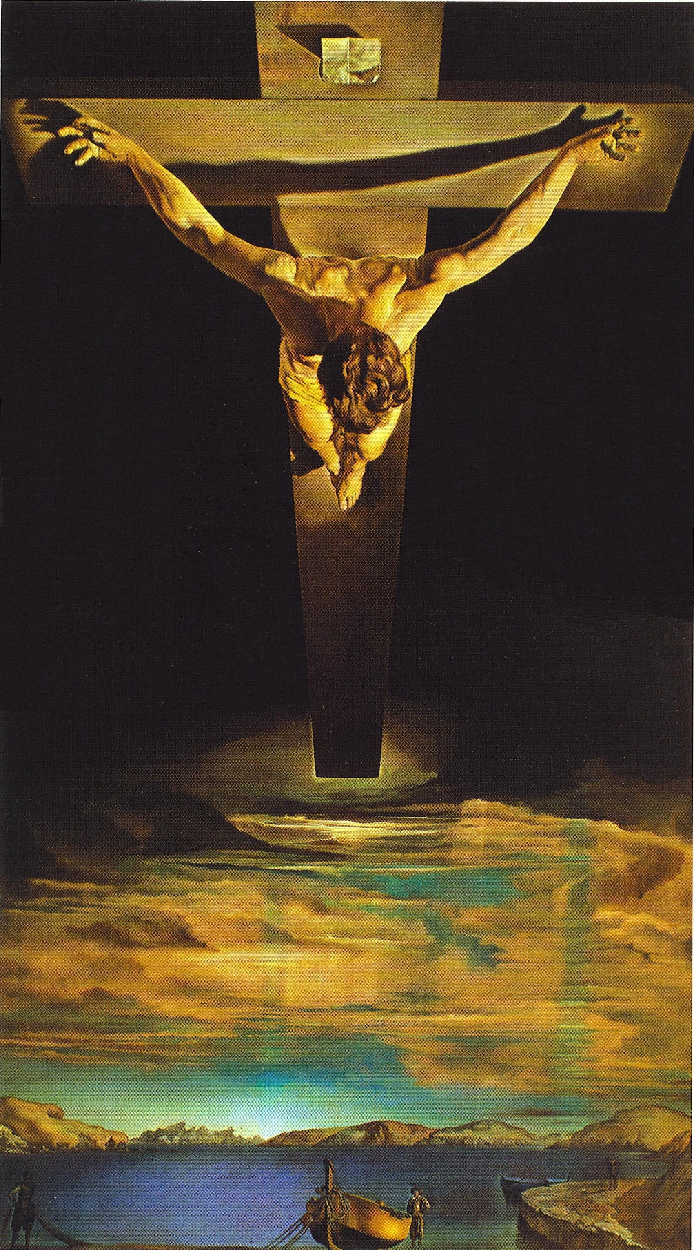
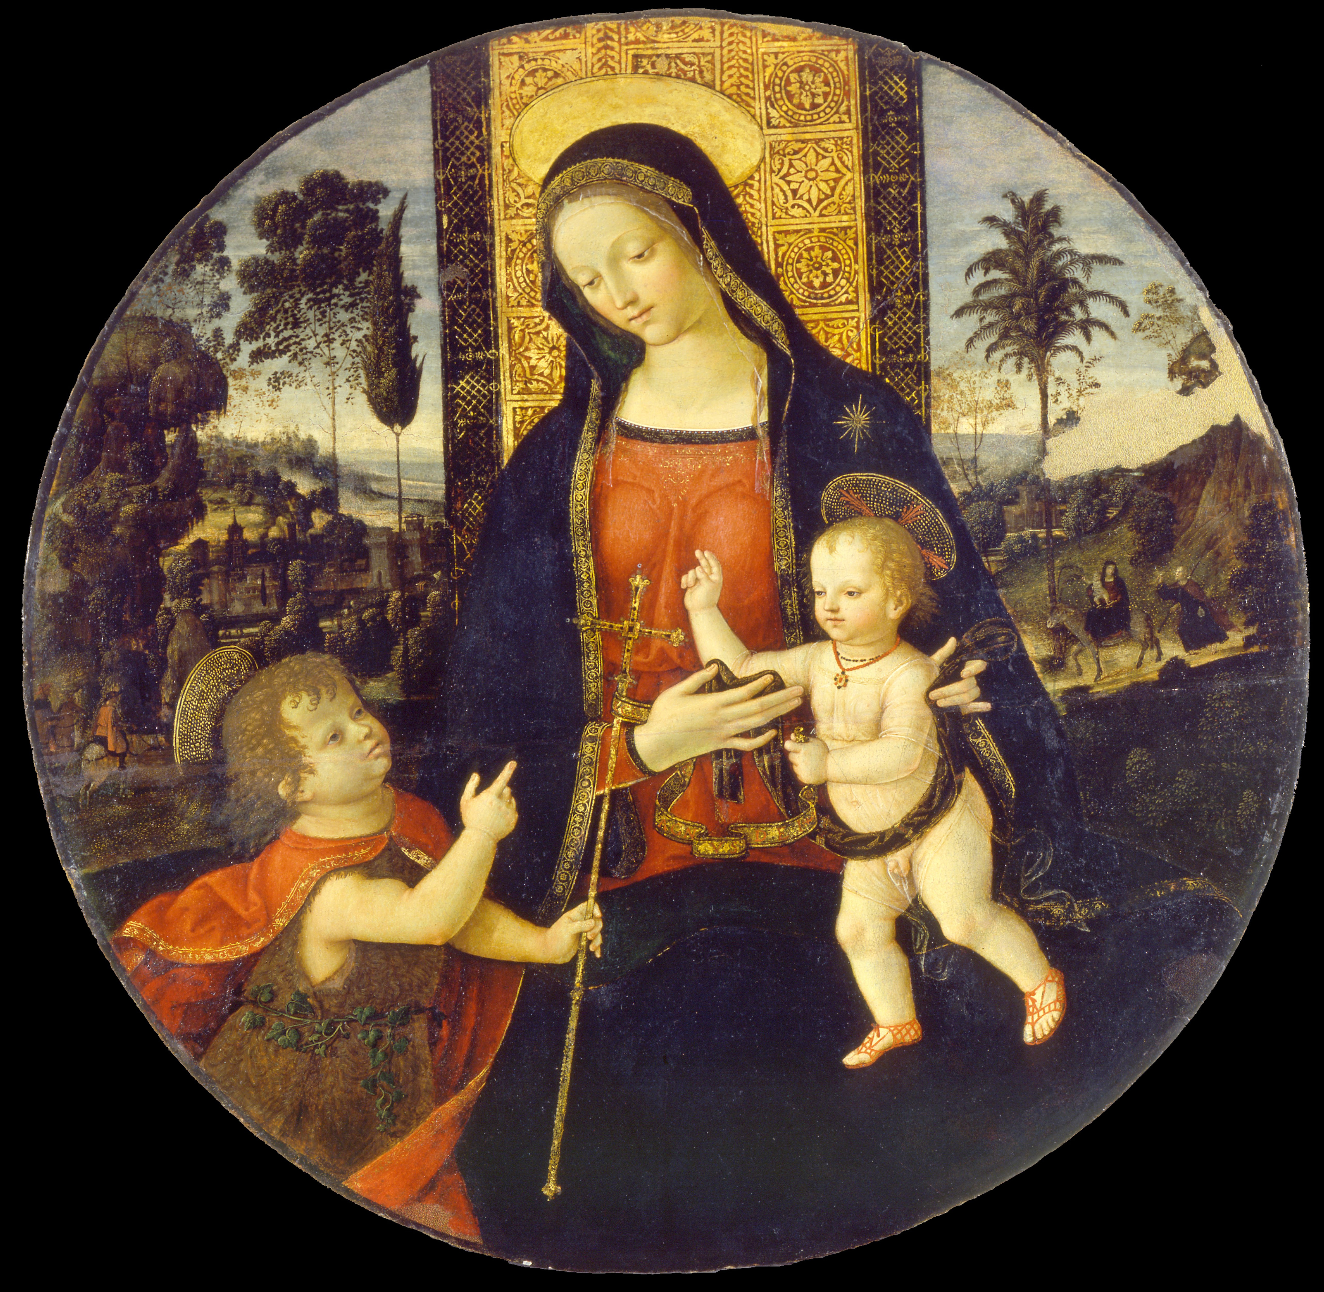
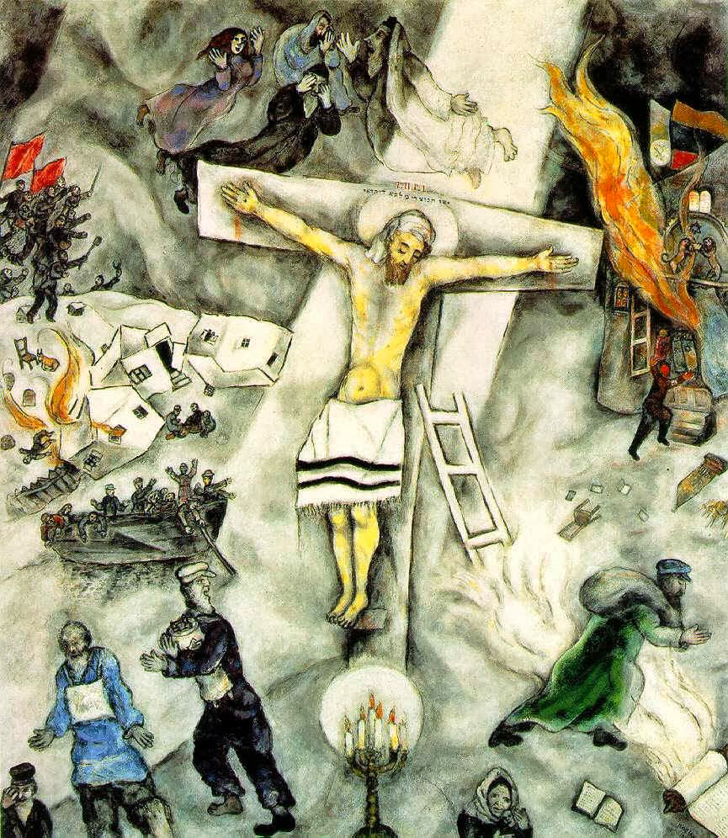
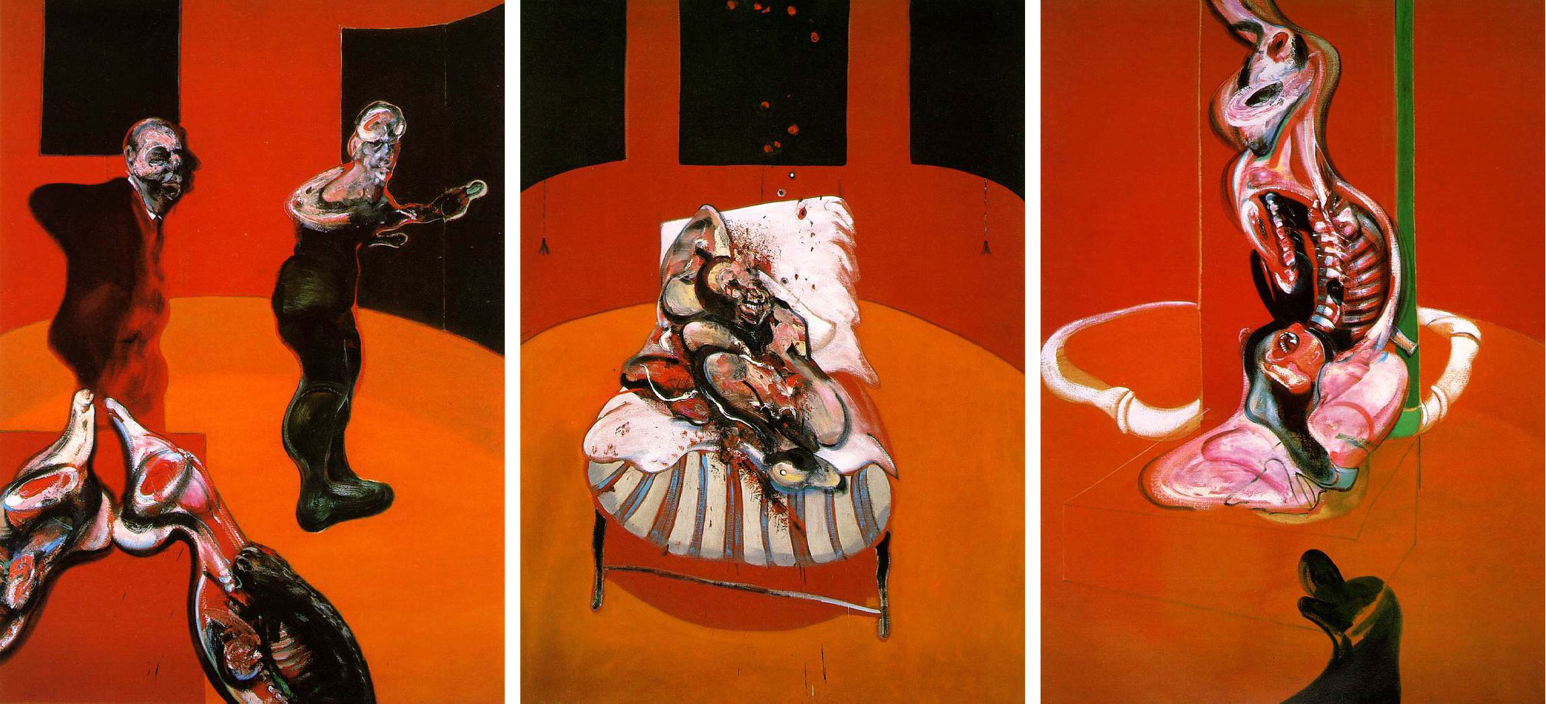
Making Connections:

Slide 22
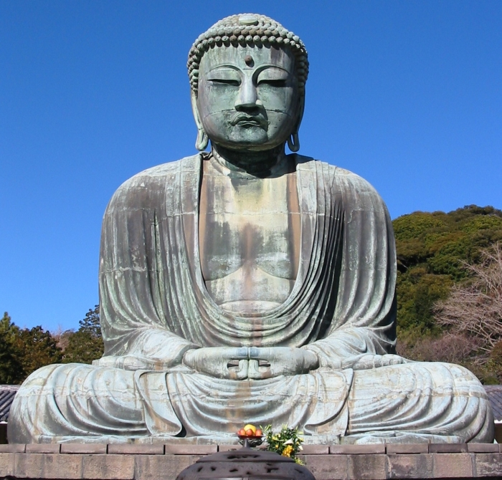
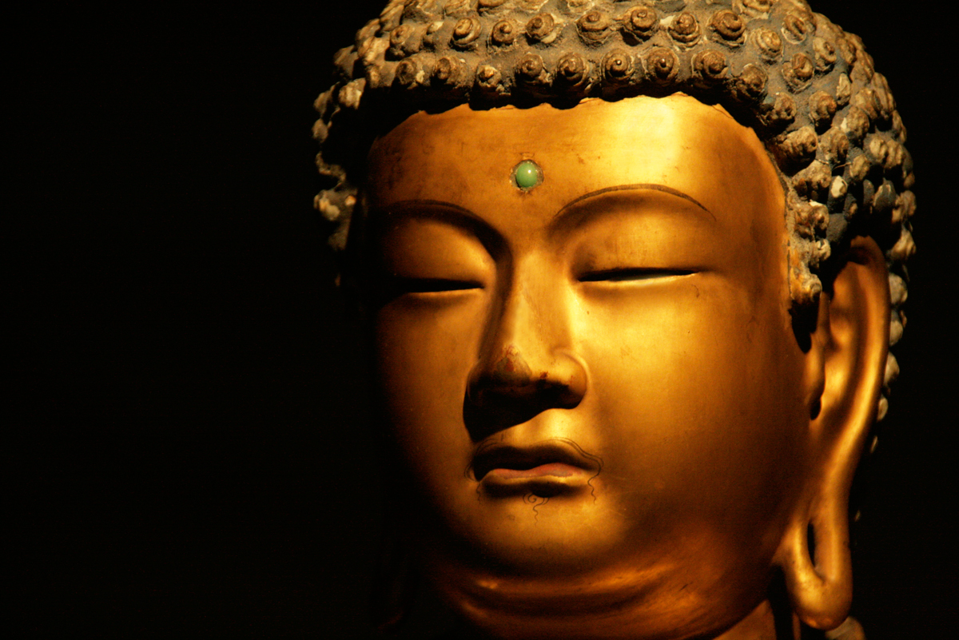
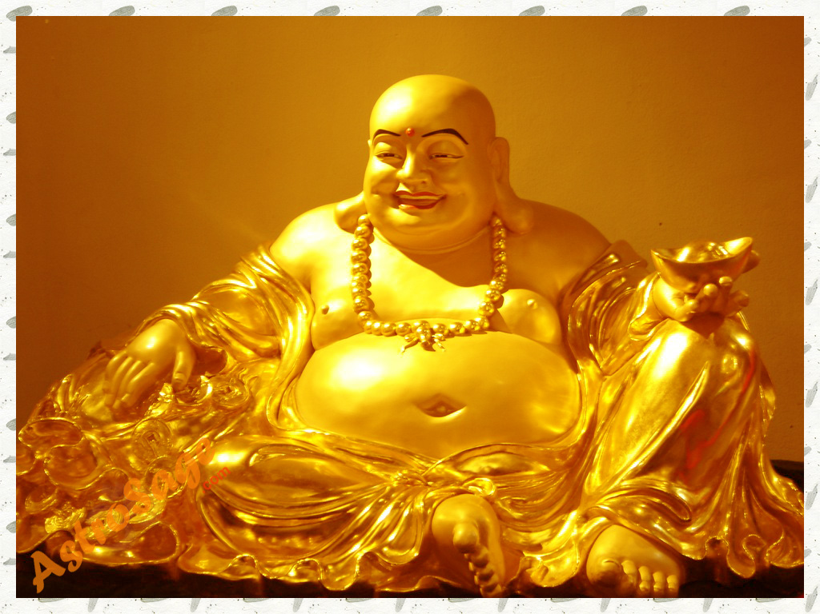
The Rise of Buddhism

Slide 23
The Life of the Buddha
One of the most interesting parallels of two historical developments happening at the same time is the spread of Buddhism in the East and the emergence of Christianity in the West, both of which occurred during the first century of the Christian era.
Siddhartha Gautama, known as the Buddha, or “Enlightened One,” lived in India some three to five centuries before Jesus. Born into a princely Hindu family, he was well educated and protected from the experience of pain and suffering. At his birth, an old sage foretold that Siddhartha would become an ascetic or a supreme monarch, so his father did everything in his power to protect his son from becoming an ascetic.
Upon leaving the palace one day he encountered a diseased man, a wrinkled old man, and a rotting corpse. The realization of these three truths of existence, led the twenty-nine year old to renounce his wealth, abandon his wife and child, and begin the quest for inner enlightenment.
After six years of a life of self-denial led to no more inner knowledge than he had before, Siddhartha sat under a fig tree and began the work that would lead him to enlightenment, or consciousness of reality. On the morning of the seventh day, he looked out to the morning star and at that moment he was enlightened.
Meditation would lead Siddhartha to full perception that the cause of human sufferings is desire, that is, the connection to material things.
For the next forty years, the Enlightened One preached a message of humility and compassion, the pursuit of which might lead his followers to nirvana, the ultimate release from illusion and from the Wheel of Rebirth.

Slide 24
The Message of the Buddha
With his earliest sermons, the Buddha set in motion the Wheel of the Law or dharma. The path to enlightenment was simple an begins with the Four Noble Truths. First, pain is universal, second, desire causes pain. Thirdly, ceasing to desire relieves pain, and finally, right conduct leads to release from pain.
The Buddha was an eloquent teacher whose concerns, like those of Jesus, were ethical and egalitarian. In accordance with Hinduism, the Buddha encouraged the annihilation of worldly desires and renunciation of material wealth. His ideas were arrived at through reasoning, not divine revelation, which makes Buddhism just as much a philosophy as it does a religion.
The Buddha himself wrote nothing, but his disciples memorized his teachings and after being passed down orally for 400 years, they set them down during the first century B.C.E. in three main books, the Pitakas or “Baskets of the Law.” These works, written in Pali and Sanskrit, were divided into chapters known as sutras (Sanskrit for “thread.”)
The most famous of the Buddha’s works is the sermon the sermon he preached to his disciples at the Deer Park in Benares. With its emphasis on modesty, moderation, and compassion, and on the renunciation of worldly pleasures, it has much in common with Jesus’ Sermon on the Mount. This sermon laid out the roadmap by which believers could avoid the obstacles that prevent them from understanding their true nature. It was in this sermon that Buddha laid out the Four Noble Truths, the bedrock of the faith.
Right conduct takes the Middle Way, or Eightfold Path: right views, right intention, right speech, right action, right livelihood, right effort, right mindfulness, and right concentration. The Eightfold Path leads to insight and knowledge, and ultimately, to nirvana. The Buddhist’s goal is not the promise of personal immortality, like Christians, but rather, the escape from the endless cycle of birth, death, and rebirth. For Buddhist’s “salvation” lies in the extinction of the Self and becoming “empty.”

Slide 25




The Four Noble Truths
Dukkha
Suffering is a universal part of life
Nirodha
Suffering ceases when we let go of desire and ego
Samudaya
Desire Causes Suffering
Magga
Follow the Eightfold Path to achieve detachment

Slide 26

The Eightfold Path:
Right Understanding: Understanding the Buddha’s teachings.
Right Intention: Improving yourself, mentally and physically.
Right Speech: Making no hurtful of negative speech; telling no lies.
Right Action: No killing, stealing, or harming others.
Right Livelihood: Living and working in a peaceful way.
Right Effort: Thinking positive thoughts.
Right Mindfulness: Being aware of your own-and others’-bodies, feelings, and thoughts.
Right Concentration: Thinking only wholesome thoughts and actions.

Slide 27
The Spread of Buddhism
During the third century B.C.E., the emperor Asoka made Buddhism the state religion of India. Asoka matched the efforts of Constantine in the West, but went further by initiating official policies on nonviolence, promoted vegetarianism, and defended egalitarianism.
In spite of Asoka’s efforts to give the world a unified faith, the Buddha’s teachings generated varying interpretations and numerous factions. By the first century C.E., there were as many as 500 major and minor Buddhist sects in India alone. In general, however, two principal versions of Buddhism emerged: Hinayana (“Lesser Vehicle”) Buddhism and Mahayana (“Greater Vehicle”) Buddhism. The term Hinayana has been replaced by Theravada and is no longer used due to the implication that “lesser vehicle” is a derogatory term coined by the Mahayana Buddhists.
Theravada Buddhism emphasized the personal pursuit of nirvana and its followers consider in that doing so they remain close to the teachings of the Buddha and his emphasis on self-destiny. Mahayana Buddhism, on the other hand, elevated the Buddha to a level of a divine being. It taught that the Buddha was the path to salvation, that he had come to the earth in the form of a man to guide humankind.
Mahayana Buddhism developed the concept of many different Buddhist divinities who inhabit the heavens, but also manifested themselves in earthly form in order to help believers attain enlightenment. These “Buddhas-to-be” or bodhisattvas are beings who have reached enlightenment, but who-out of compassion-have held back from entering nirvana until every last soul has been brought to enlightenment. Bodhisattvas are the heroes of Buddhism, akin to Christian saints, and they became objects of many popular Buddhist cults.

Slide 28
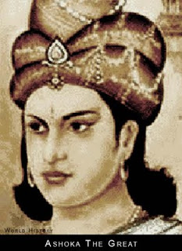
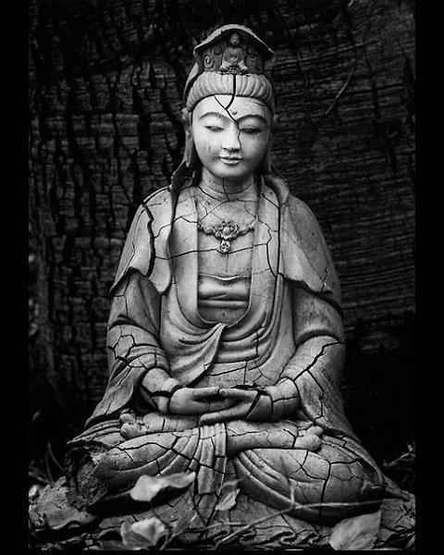
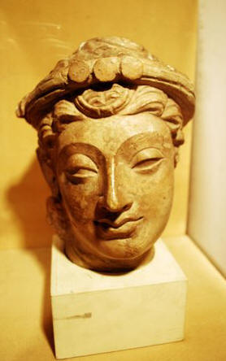
Despite Asoka’s efforts, Buddhism never gained widespread popularity in India. The strength of the established Hindu tradition in India ultimately hindered the success of the new faith, and by the year 1000, Buddhism was the religion of a minority.
Buddhism did continue to thrive in lands far from its place of birth. In China, Mahayana Buddhism gained an overwhelming following and influence. From China, he new religion spread also to Korea, Japan, and Vietnam. Buddhism’s tolerance for other religions enhanced its popularity and universal appeal. Theravada Buddhism dominated as the faith in Sri Lanka, and spread to Burma, Thailand, and Cambodia.
Still another Buddhist sect, known in China as Chan (“meditation”) and in Japan as Zen, rose to prominence in the later centuries of the first millennium. Chan emphasized the role of meditation and visionary insight in reaching nirvana.
Bodhisattvas are the “Buddha’s helpers.” A person who is bound for and ready for enlightenment, but is still subject to birth, illness, death, sorrow, and delusion. A bodhisattva remains to help those who have not yet obtained enlightenment.
There are three levels of the bodhisattva ideal: The King-like bodhisattva is one who aspires to become a Buddha first in order to help sentient beings, the Boatman-like bodhisattva is one who aspires to become a Buddha at the same time as sentient beings, finally, the Shepard-like bodhisattva, is one who aspires to become a Buddha only after all other sentient beings have done so.

Slide 29
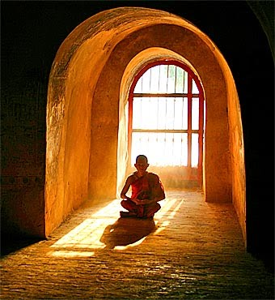

Buddhist Monks:
Both lay and monastic Buddhists commit to the following precepts:
Not to kill
Not to steal
Not to act in an unchaste manner
Not to speak falsely
Not to take intoxicants
In addition, monks vow the following:
Not to eat at times not appointed
Not to view entertainments deemed as “secular”
Not to wear perfumes or bodily ornaments
Not to sleep in beds that are too high or too wide
Not to accept money

Slide 30

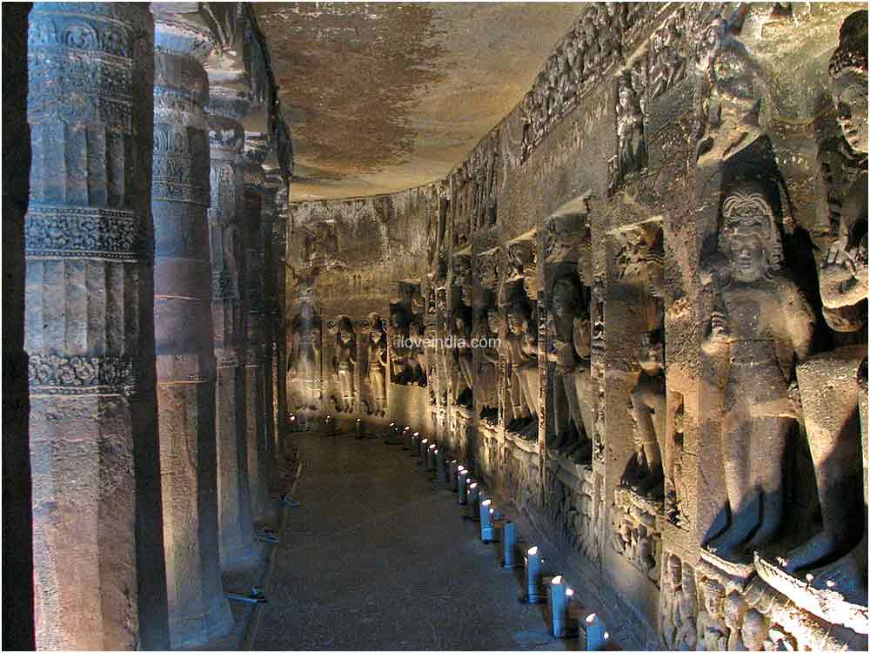
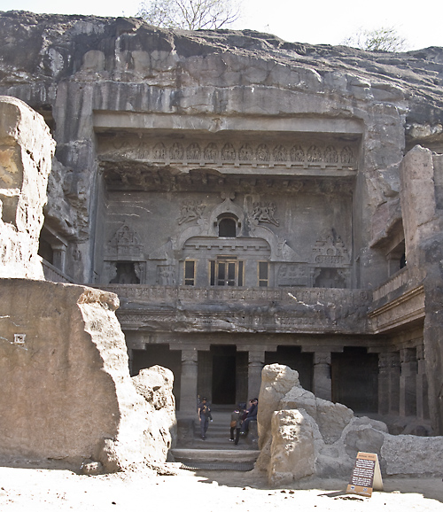
Buddhist Art:
The Ajanta Caves in India, (created around 200 B.C.E.) served as monasteries for over 800 years and contain some of the earliest images of the Buddha in art.

Slide 31
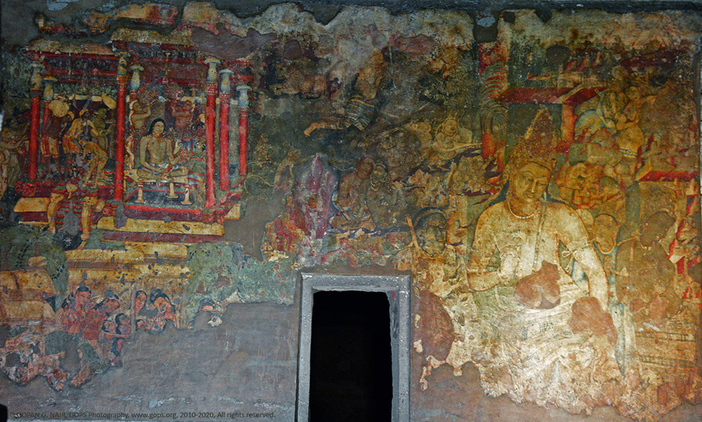
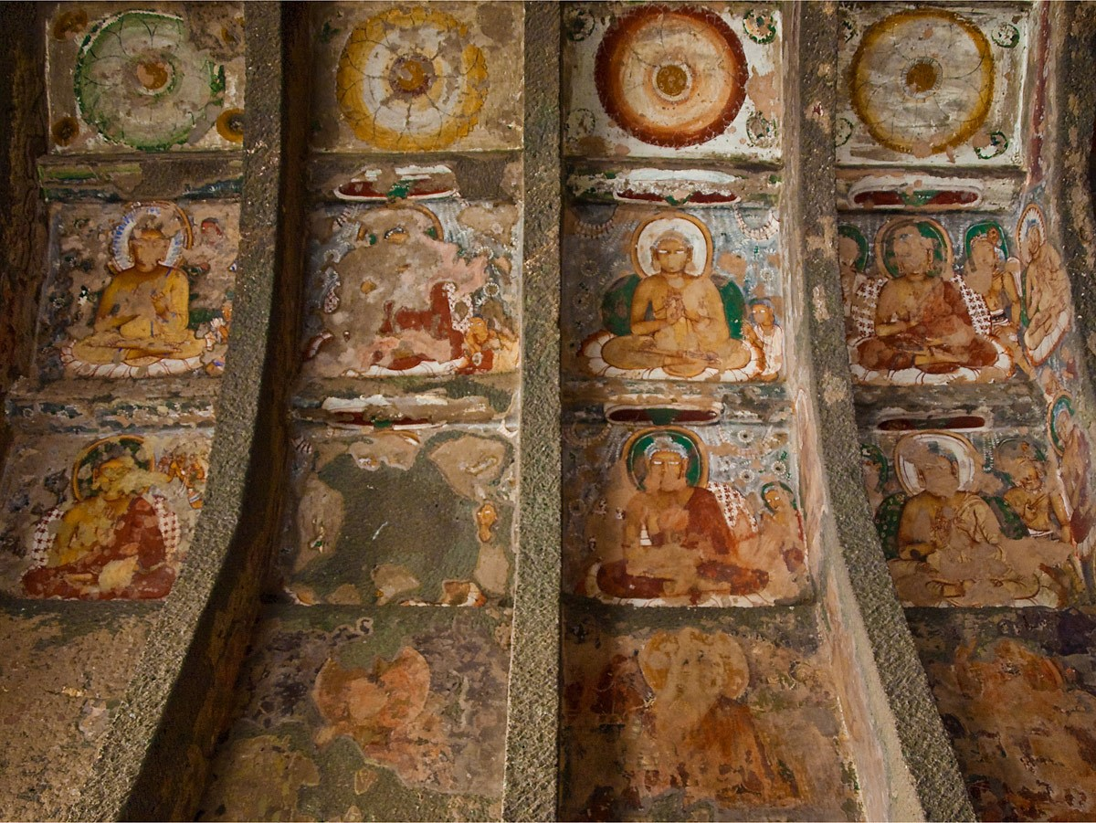
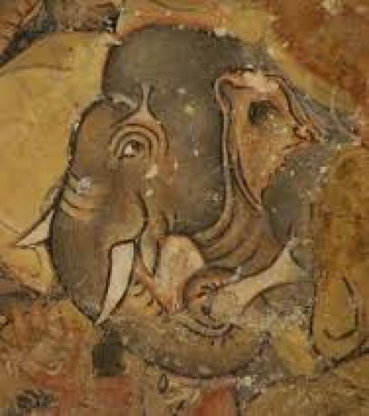
Buddhist murals inside the Ajanta Caves, India

Slide 32
Buddhist Architecture in India
Buddhist texts relate that upon his death, the body of the Buddha was cremated and his ashes divided and enshrined in eight burial mounds, or stupas. When the emperor Asoka made Buddhism the state religion of India in the third century, he further divided the ashes, distributing them among some 60,000 shrines.
The most typical of the Buddhist structures, the stupa is a beehive-like mound of Earth incased by brick or stone. Derived from the prehistoric burial mound, it symbolizes at once the World Mountain, the Dome of Heaven, and the hallowed Womb of the Universe. A hemisphere set atop a square base, the stupa is also the three-dimensional realization of the cosmic mandala- a diagrammatic map of the universe used as a visual aid to meditation.
Four gates mark the cardinal points of the compass; the walls and gates are carved with symbols of the Buddha and his teachings. As Buddhist pilgrims pass through the east gate and circle the stupa clockwise, tracing the path of the sun, they make the sacred journey that awakens the mind to the rhythms of the universe.
Begun in the third century B.C.E., the Great Stupa at Sanchi in central India was one of Asoka’s foremost achievements. Elevated on a 20 foot drum and surrounded by a circular stone railing and four stone portals, the shrine is 105 feet in diameter and rises to a height of 50 feet. It is surmounted by a series of chatra, umbrella like shapes that signify the sacred bo tree under which the Buddha reached nirvana. The chatras also symbolize the levels of human consciousness through which the soul ascends in seeking enlightenment.
Occasionally, stupas were enclosed in massive, rock-cut caves or placed at the end of arcaded hall adjacent to monastic dwellings. Known as chaitya halls, these spaces were used for individual meditation and prayer.

Slide 33
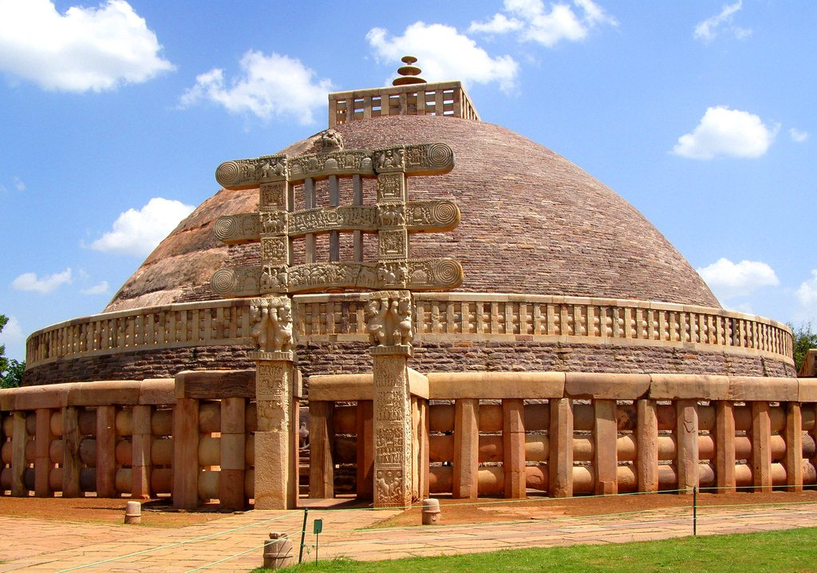
The Great Stupa at Sanchi, central India

Slide 34

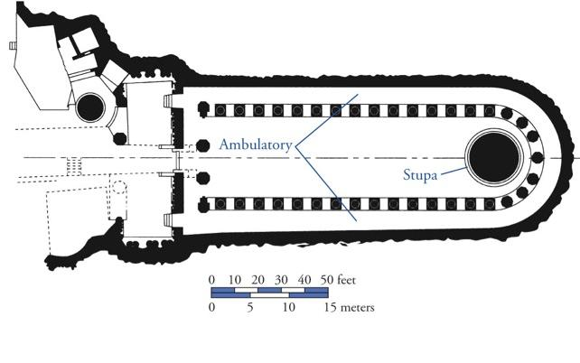
Elevation and Ground Plan for Chaitya Cave
Karli, India

Slide 35
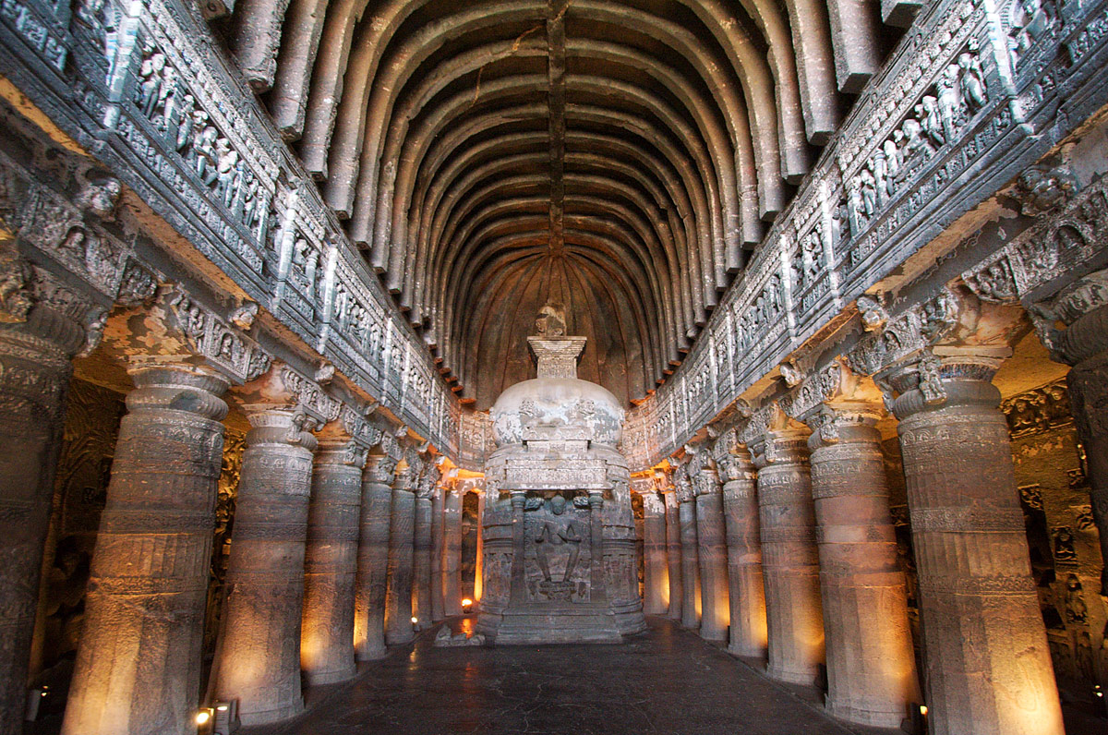

Slide 36
Buddhist Art and Architecture in China
Between the first and third centuries, Buddhist missionaries introduced many of the basic conventions of Indian art and architecture into China. The Chinese adopted the stupa as a temple shrine and place of private worship, transforming its mound like base and umbrella-like structure into a pagoda, or multi-tiered tower with many roofs. These temple towers are characterized by sweeping curves and upturned corners similar to those used in ancient watchtowers. At the same time, they recreate the image of the spreading pine tree, a altruistic sign in Chinese culture.
The earliest dated Buddhist building in China is the twelve-sided brick pagoda on Mount Song in Henan, which served as a shrine for the nearby monastery. Constructed in he early sixth century, this pagoda has a hallow interior which may once have held a large statue of the Buddha.
The Chinese preference for abstract patterns, and flowing rhythmic lines dominate the relief carvings in the limestone rock walls of the late fifth and sixth century Buddhist caves at Longmen. Once painted with bright colors, the reliefs show the emperor Xuanwu and his consorts bearing rituals gifts to he shrine of the Buddha. These reliefs are permanent memorials of worldly rulers in the act of religious devotion.

Slide 37

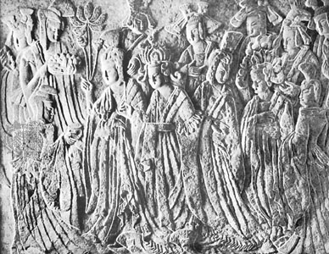
Pagoda at Mount Song
Buddhist Relief at Longmen

Slide 38

Buddhist Pilgrimage Sites:
Lumbini, Birthplace of Buddha

Slide 39
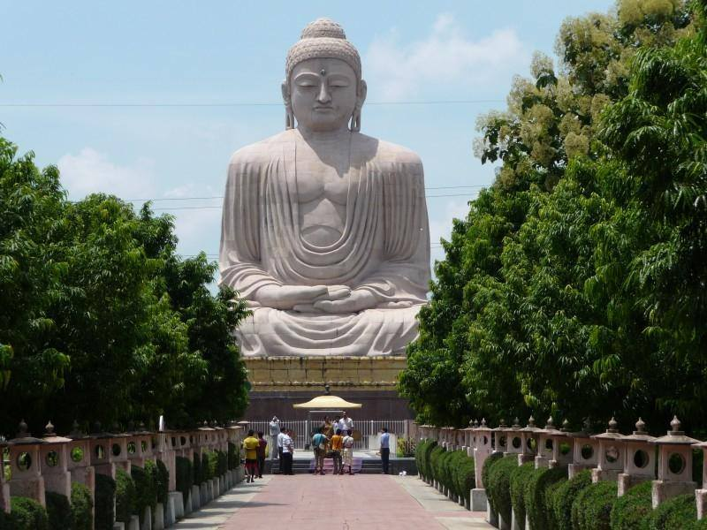

Bodh Gaya, Place where Buddha was enlightened under the Bodhi Tree

Slide 40

Sarnath, the place where Buddha first taught the Dharma

Slide 41


Kusinagara, place where Buddha passed away

Slide 42





Buddhist Mandalas

Slide 43



Sangeeta Abhay
Indian Modern Artist

Slide 44






Making Connections:

Slide 45
Need To Know Chapter 8
Three of the most important “mystery cults” of ancient history are The Cult of Mithra, the Cult of Isis, and the Cult of Dionysus.
Early Judaism is broken into two groups: the Pharisees and the Sadducees.
The Gospels, accounts of the life and teachings of Jesus Christ, were not written until 40 years after his death.
New Christians were heavily persecuted by the Romans for not worshipping the leaders of Rome as divine, until 313 C.E., when Constantine issued the Edict of Milan, declaring Christianity legal.
Siddhartha Gautama, or “Buddha” was born into a royal Indian family, and abandoned his wife, family, and riches in a quest for inner enlightenment.
Both Jesus Christ and the Buddha did not participate in the writings of their lives and teachings. This was all done by their disciples.

Slide 46
The Language of Faith:
Symbolism and the Arts

Slide 47
The Christian Identity
Between the fourth and sixth centuries, Christianity grew from a small, dynamic sect into a full-fledged religion; and its ministerial agent, the Roman Catholic Church, came to replace the Roman Empire as the dominant authority in the West.
After the legalization of the faith in 313 by Constantine, the followers of Jesus moved toward resolving questions of church hierarchy, dogma (prescribed doctrine), and liturgy (the rituals for public worship).
From Rome, church leaders took the Latin language, the Roman legal system, and Roman methods of architectural construction. The church retained the Empire’s administrative divisions, appointing archbishops to oversee the provinces, bishops in the dioceses, and priests in the parishes.
As Roman emperors had held supreme authority over the state, so Roman Catholic popes-the temporal representatives of Christ-would govern Western Christendom. The new spiritual order in the West was thus patterned after imperial Rome.
As Christianity spread, the story of Jesus and the meaning of his message provoked various kinds of inquiry regarding whether Jesus was human or divine, and what the status of Jesus in relation to God was. To resolve the conflicting answers to these questions church officials would convene to hammer out a systematic explanation of the life, death, and resurrection of Jesus. Does this seem like an odd way to establish a religion or just an ends to a means in an era with sparse record keeping?

Slide 48
The first worldwide council of churchmen was called by emperor Constantine, meeting in Nicaea, Turkey, in 325. At the Council of Nicaea, a consensus of opinion among church representation laid the basis for Christian dogma, and the council issued a statement of Christian belief known as the Nicene Creed.
The Nicene Creed pledges commitment to a variety of miraculous phenomena, including virgin birth, the resurrection of the dead, and a mystical Trinity comprising Jesus, God the Father, and the Holy Spirit. Challenging reason and the evidence of the senses, Christianity embraces faith and the intuition of truths that transcend ordinary understanding, and as such, it anticipates the shift from a homocentric Classical world-view to the God-centered medieval world-view.
If you lived during this period of blossoming Christianity would you have invested in the Nicene Creed?

Slide 49




The Latin Church Fathers
Saint Gregory: Roman aristocrat vital to the development of early church government. Elected to the papacy in 590. he established the administrative machinery by which all other popes would govern the Church of Rome.
Saint Jerome: A Christian educated in Rome, he translated into Latin both the Hebrew Bible and the Greek books of the “New Testament”
Saint Ambrose: He drew on Hebrew, Greek, and Asian traditions in formulating Christianity doctrine and liturgy. He wrote some of the earliest Christian hymns for congregational use.
Saint Augustine: The most profound and influential of all church fathers, his treatises on the nature of the soul, free will, and the meaning of evil made him the greatest philosopher of Christian antiquity.

Slide 50



Symbolism and Early Christian Art
Before Christianity was legalized in 313, visual symbols served the practical function of identifying new converts to the faith among themselves. Followers of Jesus adopted the sign of the fish because the Greek word for fish is an acrostic combination of the first letters of the Greek words “Jesus Christ, Son of God, Savior.” They also used the first and last letters of the alphabet, alpha and omega, to designate Christ’s presence at the beginning and end of time.
Roman converts to Christianity saw in the Latin word for peace, pax, a symbolic reference to Christ, since the last and first letters could also be read as chi and rho, the first two letters in the Greek word Christos. Such symbols soon found their way into Early Christian art.
On a sixteenth century sarcophagus of the archbishop Theodorus of Ravenna, the chi and rho and the alpha and omega have been made into an insignia that resembles both a crucifix (symbolizing Christ as Savior) and a pastoral cross (symbolizing Christ the Shepard). Three laurel wreaths, Roman imperial symbols of triumph, encircle the medallions on the coffin lid. On either side of the central medallion are grapevines designating the wine that represents the blood of Christ. The tine birds that stand beneath the vines, derived from Greek funerary art-refer to the human soul. Taken as a whole, the archbishop’s coffin is the vehicle of a sacred language signifying Christ’s triumph and the Christian promise of resurrection and salvation.

Slide 51







In Early Christian art, music, and literature, almost every number and combination of numbers was thought to bear allegorical meaning. The number 3, for instance, signified the Trinity, 5 symbolized the wounds of Jesus, 12 stood for the apostles, and 4 signified the evangelists.
The evangelists were usually represented by four winged creatures: the man for Matthew, the lion for Mark, the ox for Luke, and the eagle for John. Pre-figured in the Book of Revelation each of the four creatures came to be associated with a particular gospel. The lion, for example, was appropriate to Mark because in his gospel he emphasized the royal dignity of Christ; the heaven-soaring eagle suited John, who produced the most lofty and mystical of the gospels.
The halo, a zone of light used in Roman art to signify divinity or holiness, became a favorite symbolic device in the visual representation of Jesus, the evangelists, and others whom the Church canonized as holy persons capable of interceding for sinners.

Slide 52

Early Christian and Byzantine Art and Architecture:
The term “Early Christian” describes when the influence and organization of the faith were growing rapidly in the West.
As persecution by Roman authorities grew to a peak, meetings were held in secret and pieces of artwork were portable or kept hidden away from public view.
The situation improved in 313 when Constantine granted Christians full religious freedom, although it took Christian artists some time to find their own religious language. Artists borrowed classical depictions of Roman gods and utilized their favorite theme of the Good Shepard quite frequently.
In the Byzantine era, after Constantine moved the capital to Constantinople, artists were influenced by the cultures of the Near East, creating their first masterpieces in mosaic.

Slide 53
The Art of the Catacombs
Some of the earliest evidence of Christian art comes from the catacombs, subterranean burial chambers outside the city of Rome. These vast networks of underground galleries and rooms include gravesites whose walls are covered with frescos illustrating scenes from the Old and New Testaments.
Early Christian imagery was multi-layered and pregnant with symbolic meaning. For example, the popular figure of Jesus as the Good Shepard, an adaption of the calf- or lamb-bearing youth of Greco-Roman art symbolizes Jesus’ role as savior-protector (Shepard) and sacrificial victim (lamb). Featured in catacomb frescos and in freestanding sculpture, the Good Shepard evokes the Early Christian theme of deliverance.
In the centuries following the legalization of Christianity, stories about the life of Jesus came to form two main narrative cycles: The Youth of Christ and The Passion of the Christ. One of the earliest such scenes is that carved in low relief on the wooden west doors of Santa Sabina in Rome. Christ assumes the orans position, with arms upraised in an attitude of prayer, and set in static position that also signifies a crucified body. Despite its narrative content, the image is far from being a representation of the crucifixion of Jesus, rather, it is a symbolic statement of Christian redemption.
Early Christians had little use for the Roman approach to art as a window on the world. Roman Realism, with its scrupulous attention to time, place, and personalities, was ill-suited to convey the timeless message of a universal faith and the miraculous events surrounding the life of a savior god.

Slide 54





Religious Art from the Catacombs in Saint Priscilla, Rome

Slide 55



Slide 56


Slide 57




Slide 58


Art and Architecture of the Byzantine Era under Justinian:
The Hagia Sophia marks the golden age of Byzantine art and architecture under the leadership of the emperor Justinian (481-565).
Assuming the throne in 527, Justinian envisioned Constantinople as the “new Rome,” and sought to reunify the eastern and western parts of the old Roman Empire.
Although he did not manage to achieve this goal, he did commission one of the most monumental projects of all time: the revision and codification of Roman law. This set of legal ideas would become the basis for legal systems in most European states by the eleventh century.
Ravenna, Italy served as Justinian’s home base, where he commissioned the church of San Vitale, whose interiors boast some of the most magnificent mosaics in the history of world art.

Slide 59

Church of San Vitale, apse above the alter.

Slide 60


Mosaic representing the final image of Jesus as older, bearded, and all powerful.
Church of San Vitale
Center ceiling mosaic representing Jesus as the Lamb of God, a sacrifice.
Church of San Vitale

Slide 61


Slide 62


Slide 63


Slide 64



Slide 65







Slide 66
Early Christian Music
Early Christians distrusted the sensuous and emotional powers of music, especially instrumental music. Saint Augustine noted the “dangerous pleasure” of music and confessed that on those occasions when he was more “moved by the singing than by what was sung” he felt he had “sinned criminally.” For such reasons, the early Church was careful to exclude all forms of individual expression from liturgical music.
Hymns of praise such as those produced by Saint Ambrose were sung by the Christian congregation led by a cantor. But the most important music of Christian antiquity, and that which became central to the liturgy of the Church, was the music of the Mass, which celebrated the sacrifice of Christ’s body and blood as enacted at the Last Supper.
In the West, the service called High Mass featured a series of Latin chants, known as either plainsong, plainchant, or Gregorian chant-the last because Gregory the Great was said to have codified and made uniform the many types of religious chant that existed in Early Christian times.
One of the oldest bodies of liturgical song still in everyday use, Gregorian chant stands among the great treasures of Western music. Gregorian chant is monophonic, that is, regardless of the number of voices in the performing group, there is only one line of melody. Sung a cappella (without instrumental accompaniment) the plainsong of the Early Christian era was performed by the clergy and by choirs of monks rather than members of the congregation.
Since no method for notating music existed before the ninth century, choristers depended on memory and on marks entered above the words of the text to indicate the rise and fall of the voice.

Slide 67
Chapter 8 and 9 Need To Know
Christianity was officially legalized by Constantine in 313 C.E.
A meeting of a worldwide council of churchmen was called in Nicaea, Turkey, in 325 C.E., to create a basis for Christian dogma, called The Nicene Creed.
The four most influential Latin Church Fathers were Saint Jerome, Saint Gregory, Saint Ambrose, and Saint Augustine.
Their were 12 apostles of Christ and four evangelists. The evangelists were Mark, Matthew, Luke, and John.
Some of the earliest examples of Christian art is found in the catacombs outside the city of Rome, where frescos depicting scenes from the Old and New Testament can be found.
Buddhist art did not condemn the representation of the nude body, but regarded sexuality and spirituality as different forms of a single cosmic force.
Chinese architects transformed the Indian stupa into the pagoda, or multitiered tower with many roofs.

